Slide 1


SECURITY OPERATIONS DASHBOARD
PROJECT REVIEW
THREAT DETECTION & RISK ANALYTICS
LIVE SECURITY CONSOLE
Security
EVENTS
RISK
Operations Dashboard
LIVE
0–100
A unified security console for data aggregation, explainable AI
detection, risk prioritization, and incident response.
ATTACK CHAIN SIGNAL
NAME
MENTOR
TEAM :- B
KAPIL PANWAR

Slide 2
SECURITY OPERATIONS DASHBOARD
THREAT DETECTION / RISK ANALYTICS
Problem Statement
SOC teams need context, not another stream of disconnected alerts.
01 / ALERT FATIGUE
02 / FRAGMENTED TELEMETRY
03 / STATIC DETECTION
Too many alerts. Too little
prioritization.
Signals live in separate
systems.
Rules miss behavior that
changes.
Analysts spend time triaging raw logs
without a shared view of asset criticality,
confidence, or likely impact.
Endpoint, identity, vulnerability, and threat
intelligence data are difficult to correlate
across an incident.
Signature-only approaches struggle with
novel anomalies and can bury important
events in false positives.
OPERATIONAL GAP → A single explainable path from event to response

Slide 3
SECURITY OPERATIONS DASHBOARD
THREAT DETECTION / RISK ANALYTICS
Objectives
Turn heterogeneous security data into a defensible, actionable operating picture.
01
02
03
04
AGGREGATE
DETECT
PRIORITIZE
RESPOND
Normalize events and enrich
them with asset, vulnerability,
MITRE, and IOC context.
Use unsupervised anomaly
detection to surface behavior
that does not match the baseline.
Produce transparent 0–100 risk
scores that help analysts work
the right queue first.
Connect investigation, incident
management, recommendations,
and security posture views.
DESIGNED FOR EXPLAINABILITY · BUILT FOR FAST TRIAGE

Slide 4
SECURITY OPERATIONS DASHBOARD
THREAT DETECTION / RISK ANALYTICS
Proposed Solution
A modular pipeline that keeps the evidence chain visible from ingestion to mitigation.
M1
M2
M3
M4
Data aggregation
AI detection
Risk prioritization
Integrated
dashboard
Events, assets, CVEs, IOCs, and
MITRE mappings.
Isolation Forest scores
anomalous behavior.
Explainable scoring and
correlated chains.
Investigation, posture, incidents,
and recommendations.
ONE EVIDENCE CHAIN · FOUR IMPLEMENTATION MODULES

Slide 5
SECURITY OPERATIONS DASHBOARD
THREAT DETECTION / RISK ANALYTICS
Technology Stack
A pragmatic full-stack foundation for data-heavy security workflows.
BACKEND & DATA
ML & ANALYTICS
FRONTEND
Python
runtime
Pandas
feature prep
React
console UI
Flask
API layer
scikit-learn
Isolation Forest
Vite
build tooling
MongoDB
primary store
Joblib
model persistence
Recharts
visual analytics
CSV fallback
local demo data
REST APIs
module routes
CSS modules
responsive layout

Slide 6
SECURITY OPERATIONS DASHBOARD
THREAT DETECTION / RISK ANALYTICS
System Architecture
The dashboard keeps collection, model inference, prioritization, and user workflows as separate layers.
INPUTS
EXPERIENCE
Security events
CORE ENGINE
Dashboard
CSV / MongoDB
Detection & risk pipeline
overview & analytics
Assets & CVEs
Normalization → feature engineering → anomaly
score → risk score → correlated attack chain.
Investigation
context sources
event detail
Flask blueprints · Python services ·
persisted model
Threat intelligence
Response
IOCs / MITRE
incidents & actions

Slide 7
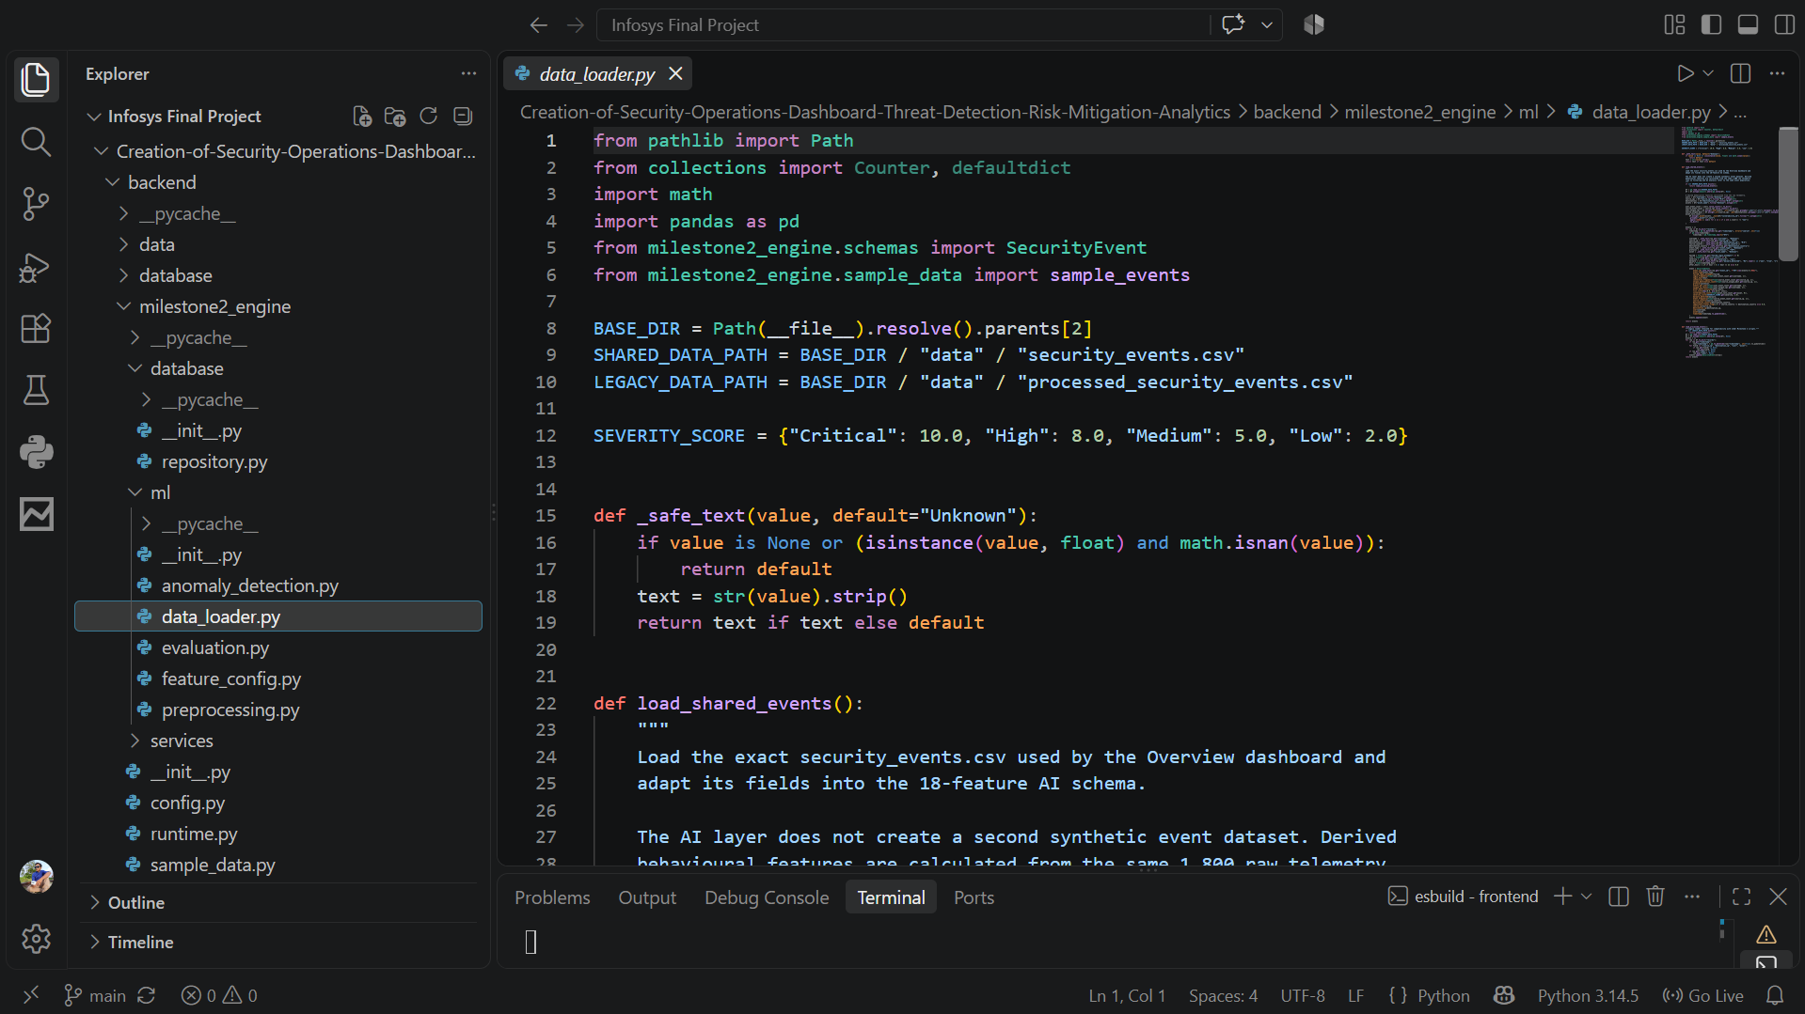
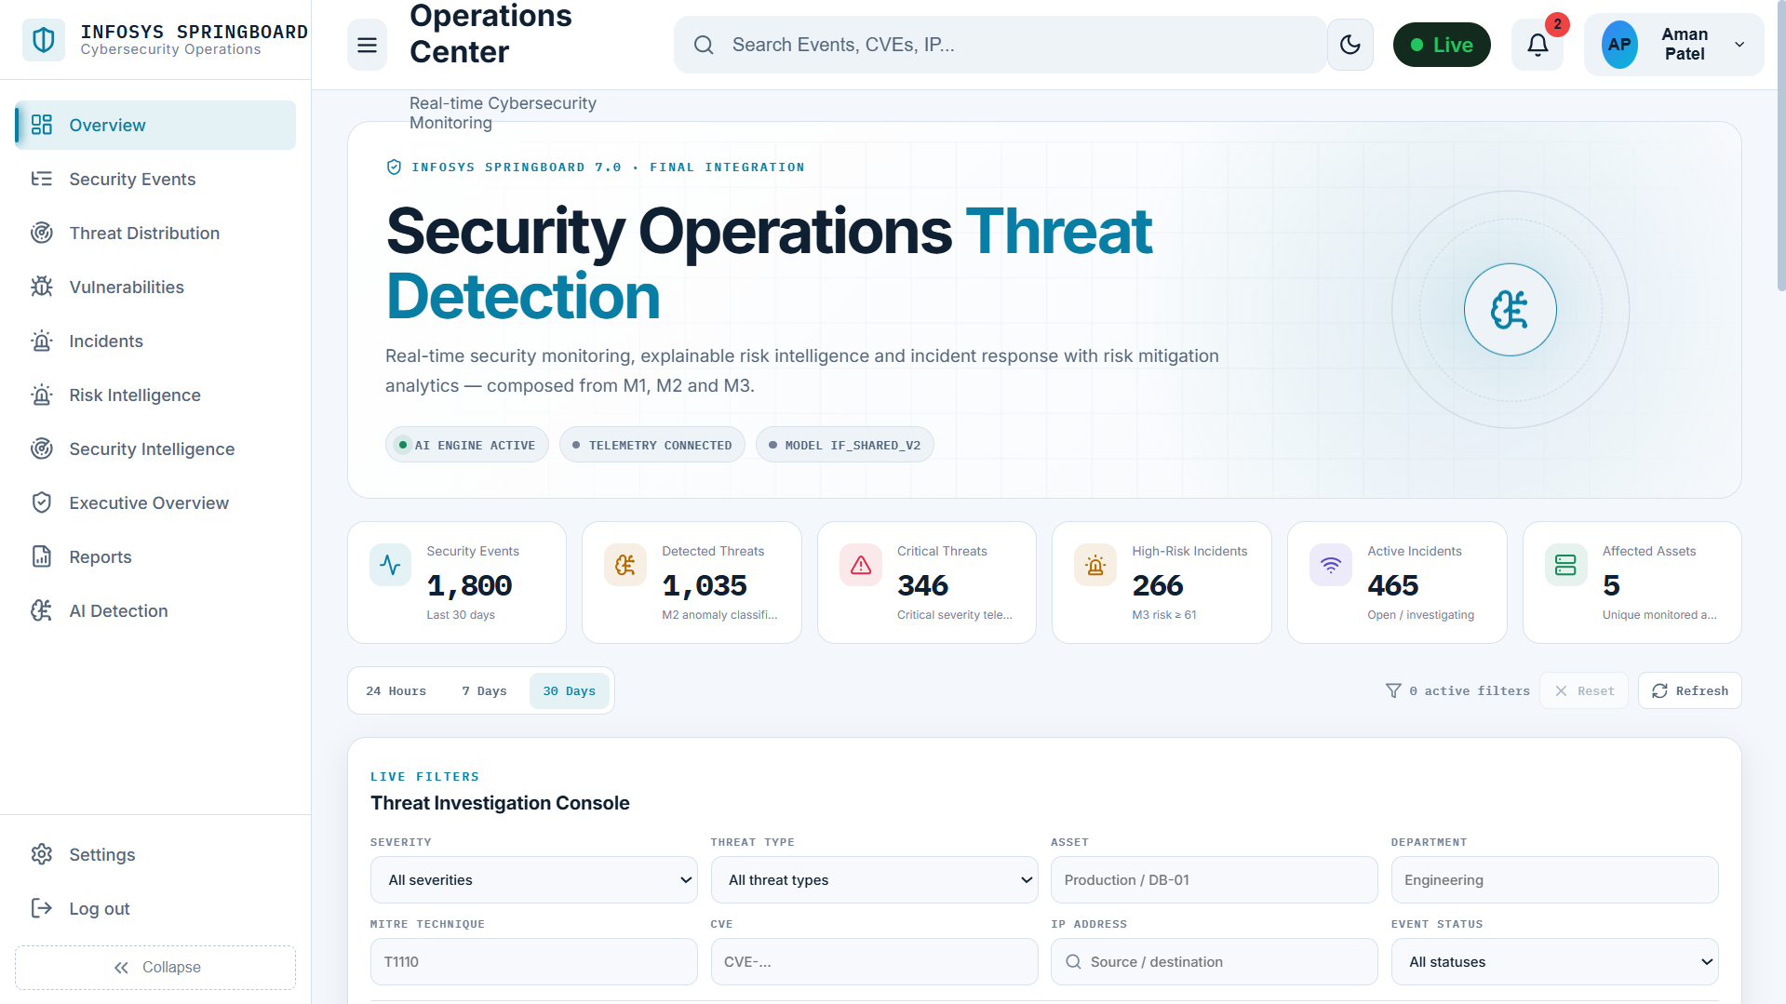
SECURITY OPERATIONS DASHBOARD
THREAT DETECTION / RISK ANALYTICS
M1 – Data Aggregation & Threat Intelligence
Implementation evidence: add your backend and frontend captures here.
BACKEND SCREENSHOT
FRONTEND SCREENSHOT
event ingestion / normalized schema
threat intelligence / enrichment view

Slide 8
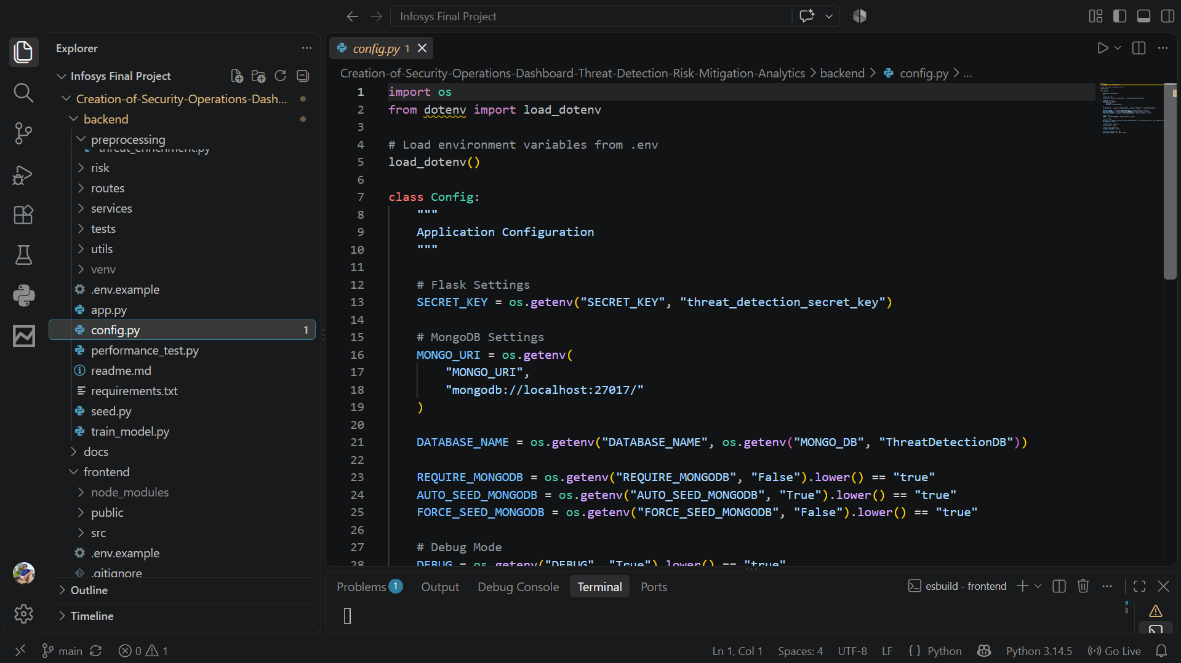
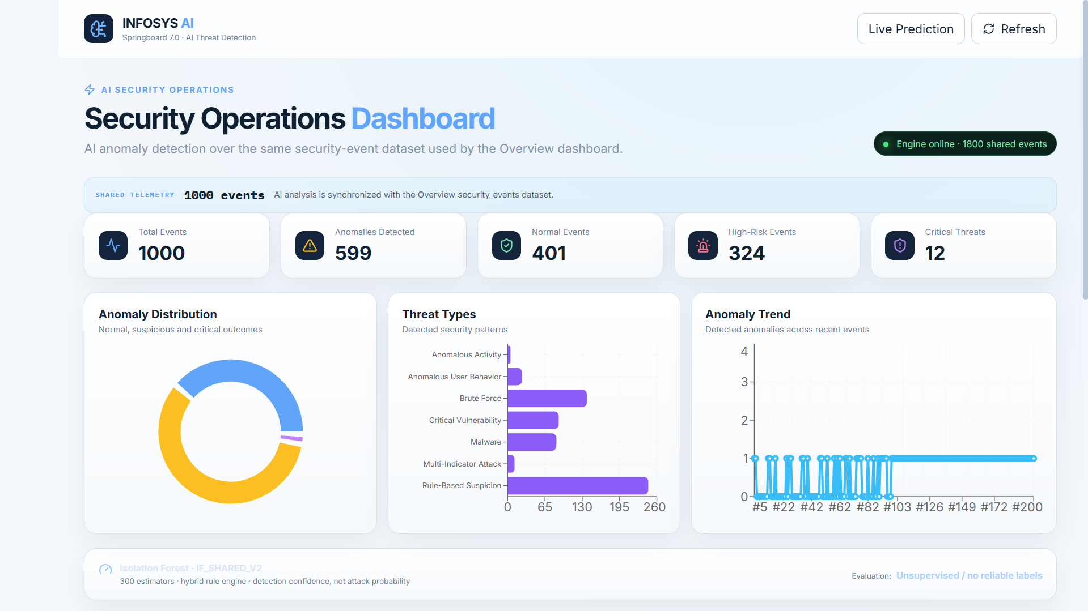
SECURITY OPERATIONS DASHBOARD
THREAT DETECTION / RISK ANALYTICS
M2 – AI Threat Detection
Implementation evidence: add the model output and the UI state that consumes it.
BACKEND SCREENSHOT
FRONTEND SCREENSHOT
Isolation Forest inference / anomaly response
AI detection results / confidence view
18 FEATURES · 300 ESTIMATORS · UNSUPERVISED DETECTION

Slide 9
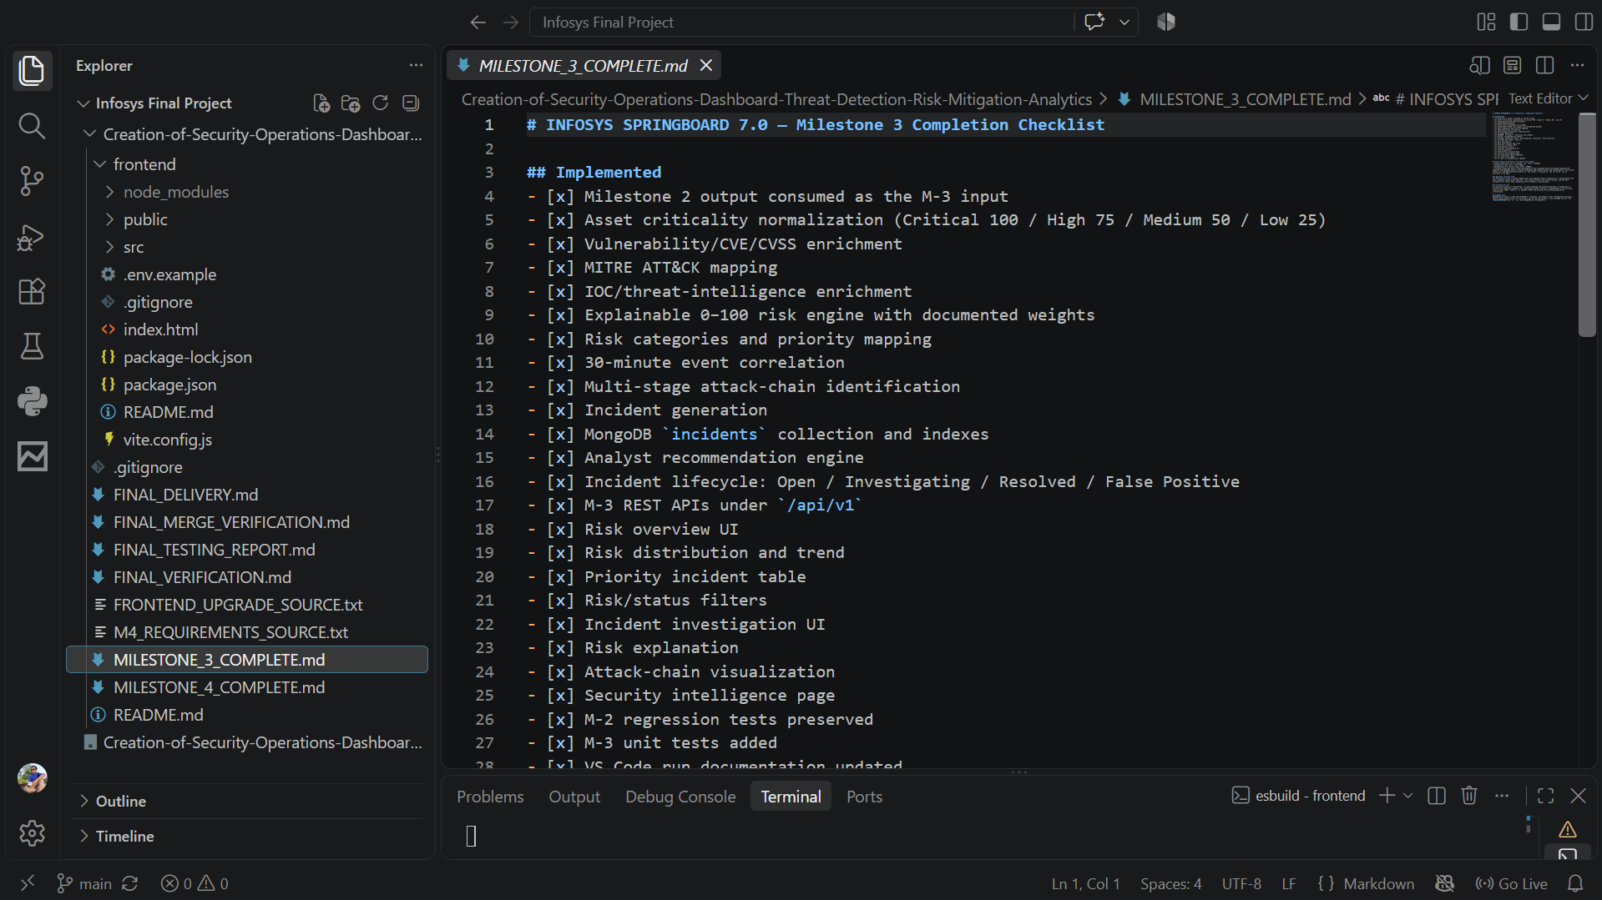
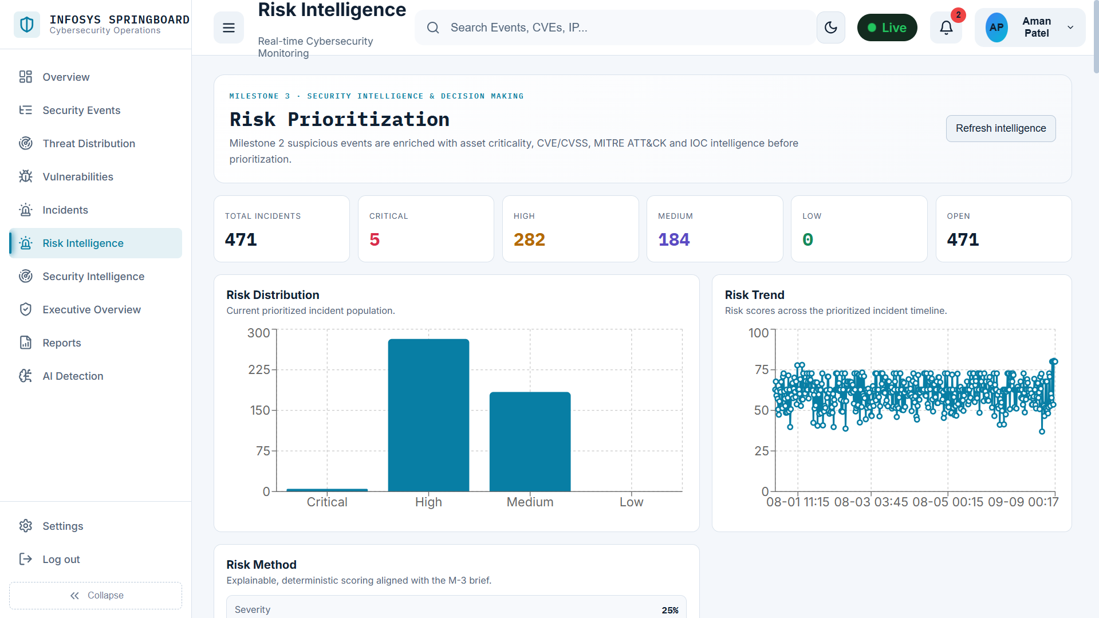
SECURITY OPERATIONS DASHBOARD
THREAT DETECTION / RISK ANALYTICS
M3 – Risk Scoring & Prioritization
Implementation evidence: show how raw model signals become a prioritized analyst queue.
BACKEND SCREENSHOT
FRONTEND SCREENSHOT
risk score / high-risk asset response
prioritized risks / explainability view
0–100 RISK SCALE · ASSET CRITICALITY · THREAT CONTEXT

Slide 10
SECURITY OPERATIONS DASHBOARD
THREAT DETECTION / RISK ANALYTICS
Attack Chain & Event Correlation
Temporal correlation turns isolated records into a sequence that an analyst can investigate.
01
03
05
Initial access
Privilege
escalation
Impact
02
04
brute force / login
burst
ransomware /
exfiltration
Execution
valid account / admin
path
Lateral movement
PowerShell / script
signal
remote service /
asset hop
CORRELATION WINDOW · 30 MINUTES · EVENTS RETAIN THEIR ORIGINAL EVIDENCE

Slide 11
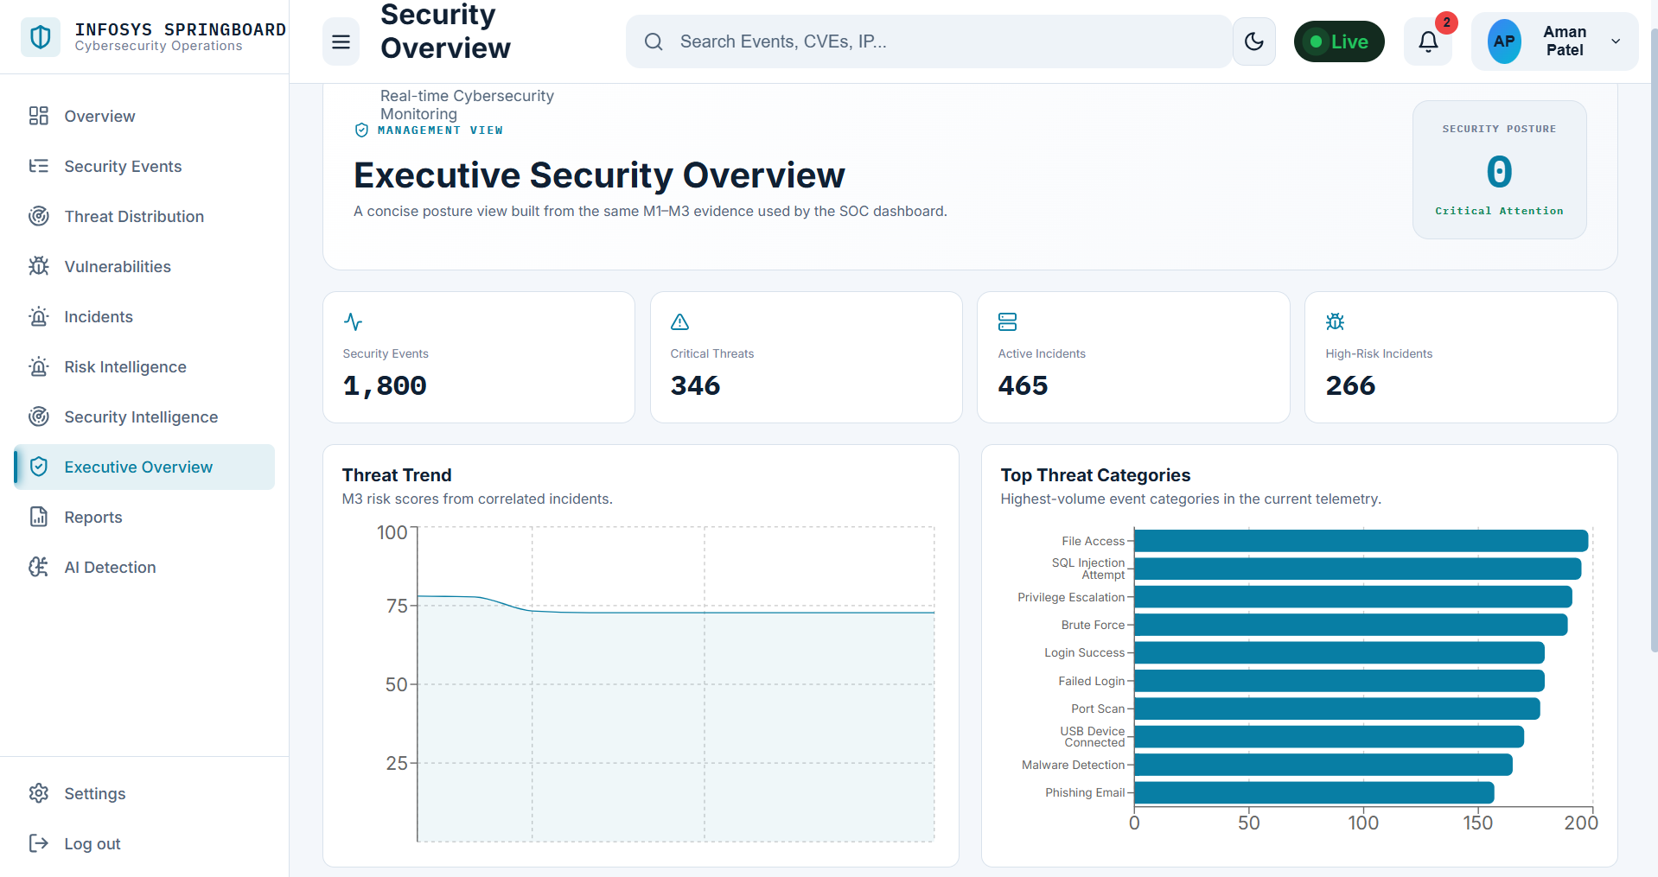
SECURITY OPERATIONS DASHBOARD
THREAT DETECTION / RISK ANALYTICS
M4 – Integrated Dashboard
Implementation evidence: show the working console and its cross-module navigation.
FRONTEND SCREENSHOT
dashboard overview / analytics / navigation

Slide 12
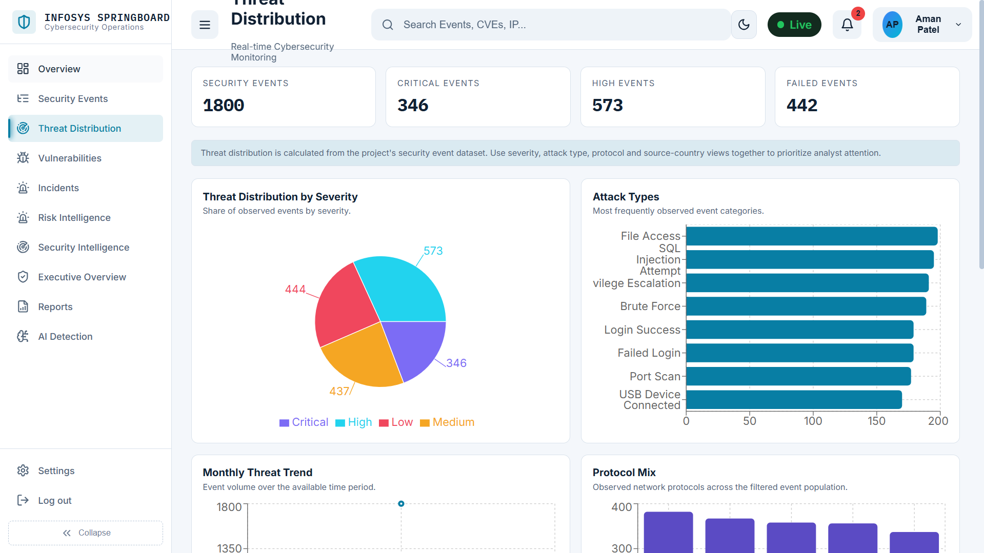
SECURITY OPERATIONS DASHBOARD
THREAT DETECTION / RISK ANALYTICS
Threat Investigation
Implementation evidence: capture the event-to-context investigation experience.
FRONTEND SCREENSHOT
event detail / investigation workspace

Slide 13
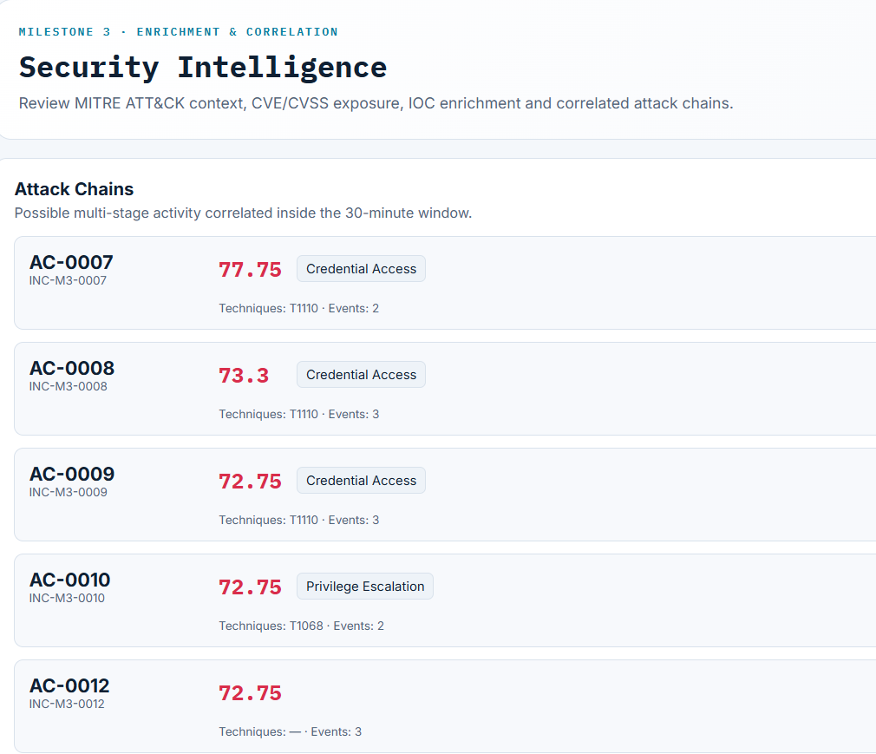
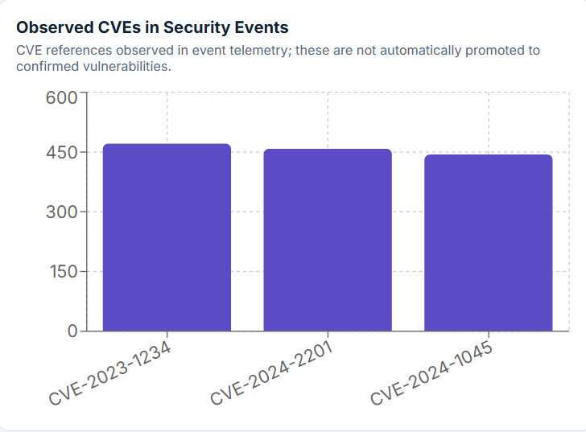
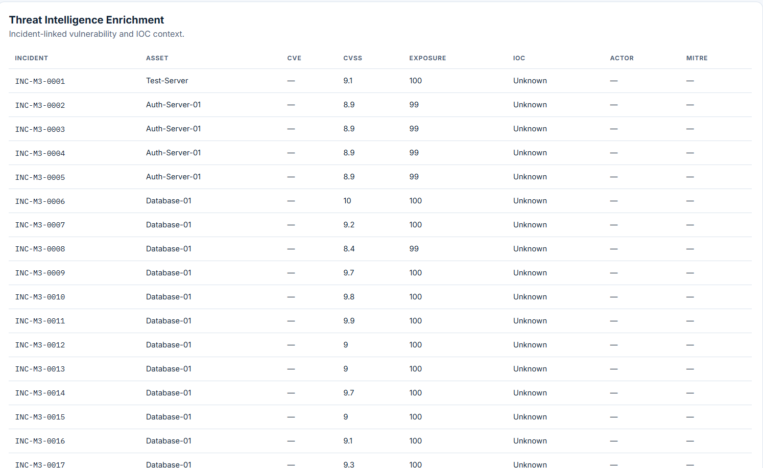
SECURITY OPERATIONS DASHBOARD
THREAT DETECTION / RISK ANALYTICS
MITRE / CVE / IOC Intelligence
Implementation evidence: add the intelligence views that ground each alert in known context.
MITRE SCREENSHOT
CVE SCREENSHOT
IOC SCREENSHOT
tactics / techniques mapping
vulnerability context
indicator reputation / lookup

Slide 14
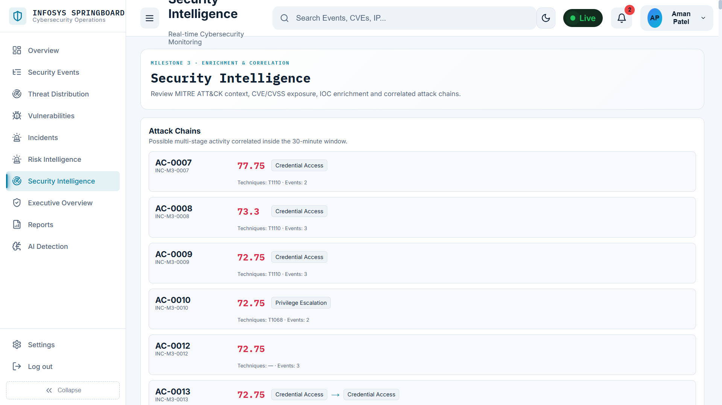
SECURITY OPERATIONS DASHBOARD
THREAT DETECTION / RISK ANALYTICS
Security Posture
Implementation evidence: show the posture view that converts detections into an organizational risk picture.
FRONTEND SCREENSHOT
security posture / exposure / risk overview

Slide 15
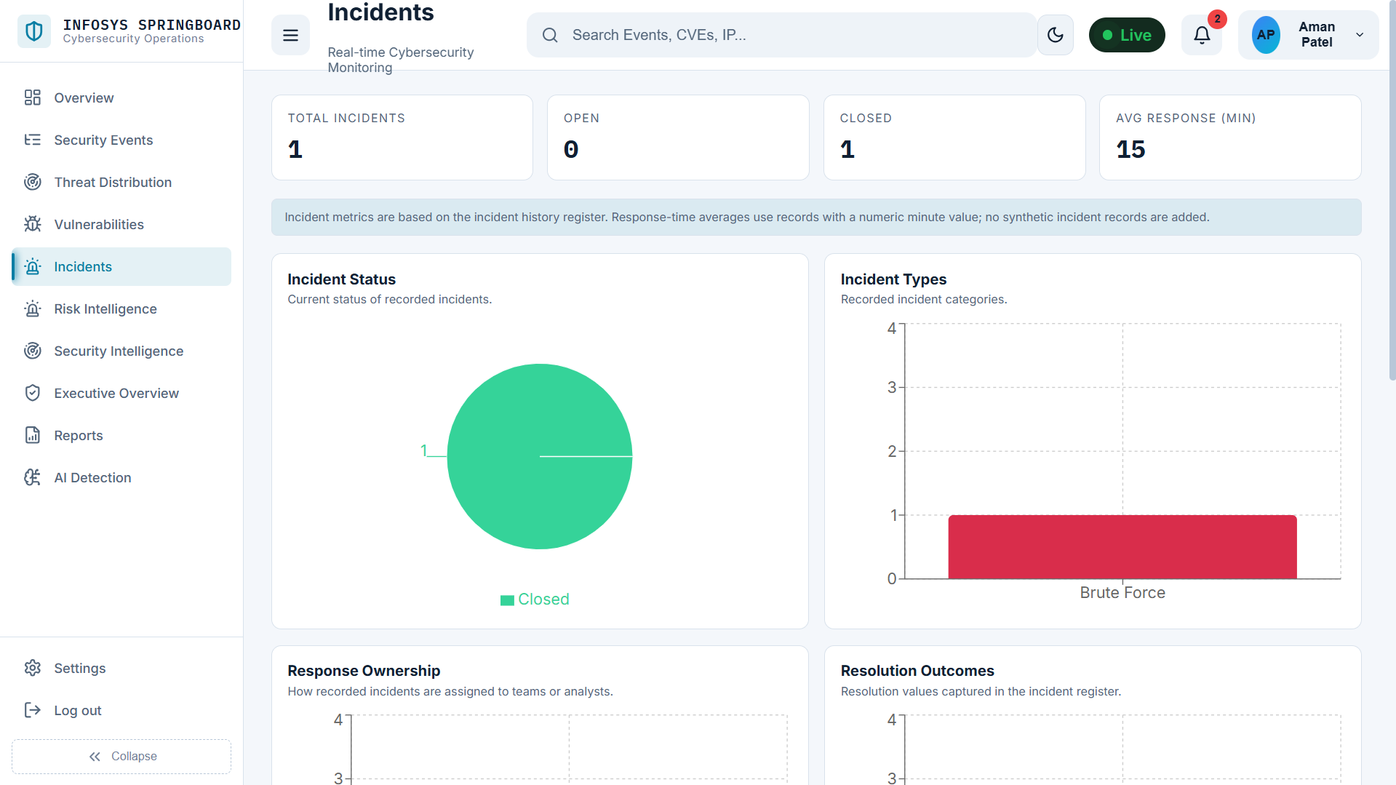
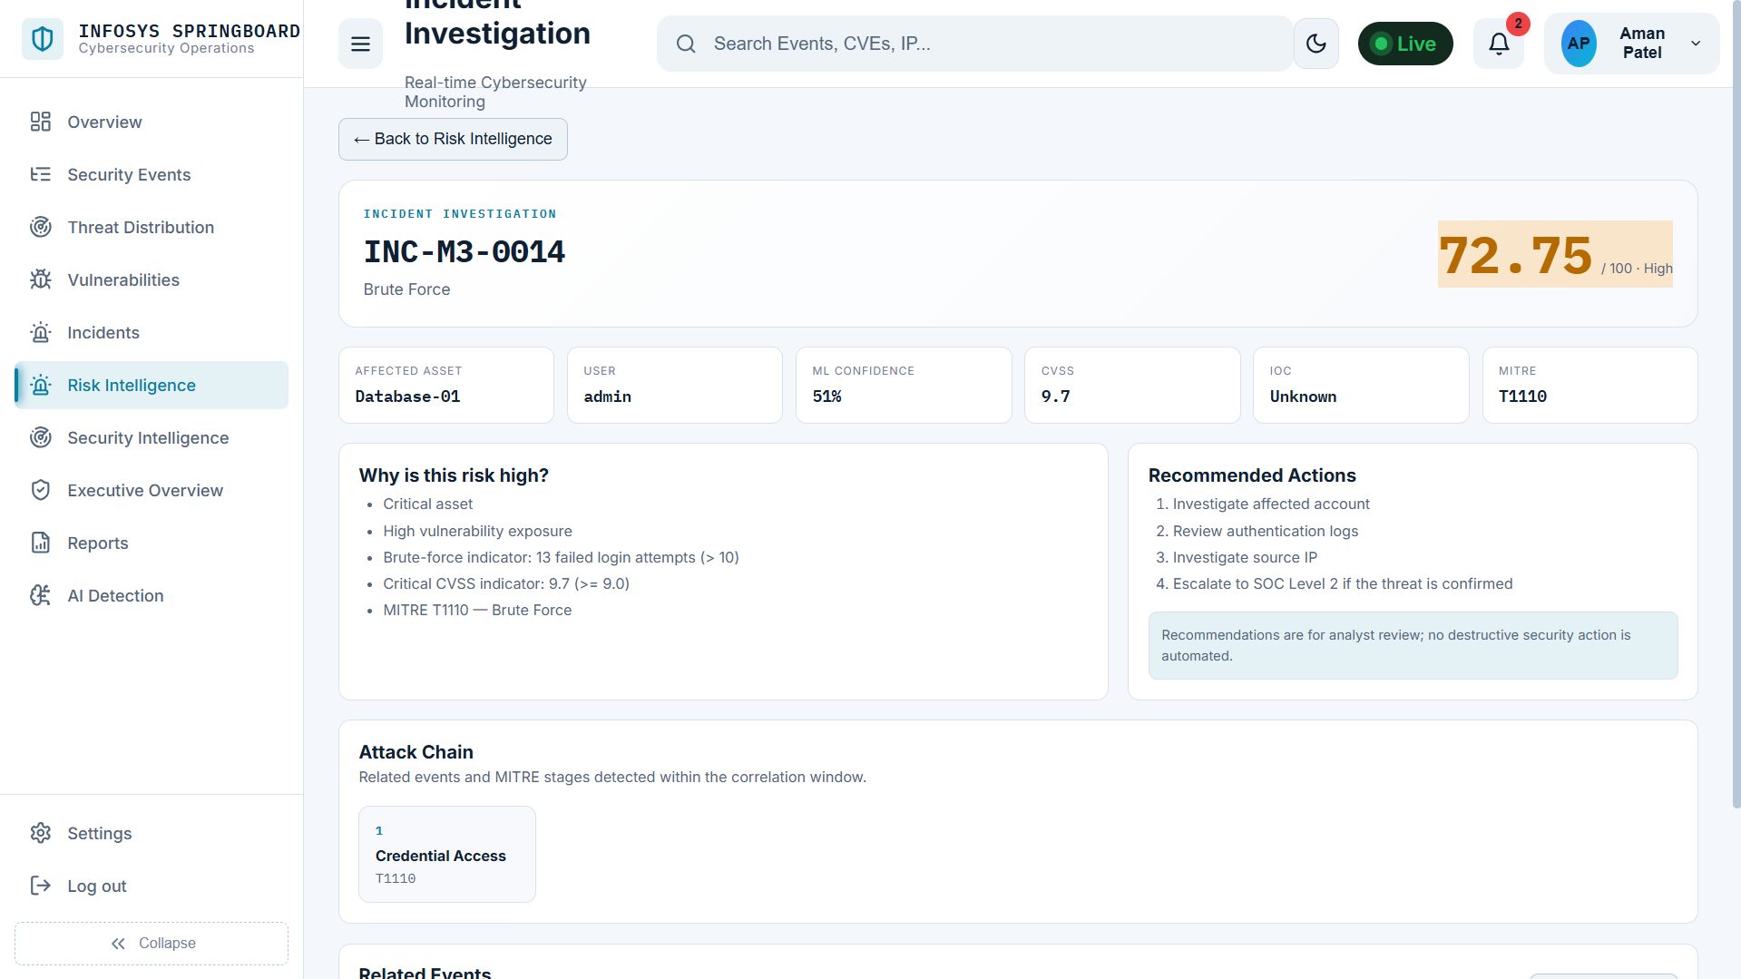
SECURITY OPERATIONS DASHBOARD
THREAT DETECTION / RISK ANALYTICS
Incident Management & Recommendations
Implementation evidence: add the incident workflow and recommended response actions.
FRONTEND SCREENSHOT
FRONTEND SCREENSHOT
incident queue / status / ownership
recommendations / mitigation actions

Slide 16
SECURITY OPERATIONS DASHBOARD
THREAT DETECTION / RISK ANALYTICS
End-to-End Workflow
Every stage leaves a trace that can be explained to the analyst and defended in review.
01
02
03
04
05
Ingest
Enrich
Score
Correlate
Respond
Collect events
and
supporting
data.
Normalize and
attach threat
context.
Detect
anomalies and
calculate risk.
Build the
attack chain.
Investigate,
manage,
mitigate.
Evidence stays attached to the event.
Risk stays visible through response.
Analyst action feeds the next decision.

Slide 17

SECURITY OPERATIONS DASHBOARD
THREAT DETECTION / RISK ANALYTICS
Testing & Results
Show the evidence from the implementation, not a documentation dump.
MODEL VALIDATION
Held-out evaluation path
When reliable labels exist, the project evaluates accuracy,
precision, recall, F1, and a confusion matrix without using
labels for training.
RESULTS SCREENSHOT
add evaluation output / dashboard evidence here
RUNTIME CHECKS
Health & pipeline endpoints
The API exposes health reporting, database status, model
readiness, and a pipeline execution route.
TEST EVIDENCE TO ADD: API RESPONSE · MODEL METRICS · UI STATE

Slide 18
SECURITY OPERATIONS DASHBOARD
PROJECT REVIEW
Conclusion + Future Scope + Q&A
A security operations dashboard that connects detection quality with analyst action.
CONCLUSION
FUTURE SCOPE
Make the risk picture easier to see,
explain, and act on.
Live streaming telemetry and connector expansion
Feedback loops for analyst-informed model tuning
The project brings security telemetry, AI-assisted detection, risk
prioritization, attack-chain context, and incident workflows into one
reviewable surface.
Automated response playbooks and richer posture
trends
Production hardening, access control, and audit reporting
Q&A
TEAM :- B · MENTOR: KAPIL PANWAR

